Slide 1


Asp.Net Core – Razor Pages
ASP.Net Core Web Developer Program @ Aitrich Academy

Slide 2

What are Razor Pages?
Razor Pages is a server-side, page-centric programming model for building web UI with ASP.NET Core.
Client Content
Server Code

Slide 3
Razor Pages
An ASP.NET Razor page has the “.cshtml” (e.g., “Index.cshtml”) file extension.
This file contains a mix of HTML and Razor syntax. The Razor syntax is actually C# code mixed together with the HTML code.
The Razor parts of the file are executed on the web server before the page is sent to the client (your web browser).
The Razor page may also have a C# code file linked to it, this file has the extension
In Razor with Page Model each Razor page is a pair of files:

Slide 4

Benefits of Razor Pages
Makes it easy to get started building dynamic web apps with html,css and c#
Encourages organization of files by feature, which eases maintanence of your app
Html + server-side c# code by using Razor syntax

Slide 5
When to use Razor Pages
Blazor
MVC
Razor Pages
Appropriate for client-heavy SPA(single page app) scenarios as React and Angular
Server-side,organized by controllers,more structured scenarios,original basis of
Razor pages
Server-side applications that are organized by feature,Easy to start,scales to large applications.

Slide 6

Razor Pages
Razor page use a markup language called Razor for embedding server-based code into webpages.
Razor syntax is combination of html and c# where the c# code defines the dynamic rendering logic for the page.
In a webpage that uses the razor syntax,there can be two kind of content:Client content and Server Code

Slide 7

Razor Pages
Client Content : Contains what you are used to in webpages.For example,HTML markup (elements),style information such as CSS, maybe some client script such as javascript , and plain text
Server Code : Razor enables you to add server code to your client content.if there is server code in the page,the server runs that code first , before it sends the page to the browser

Slide 8
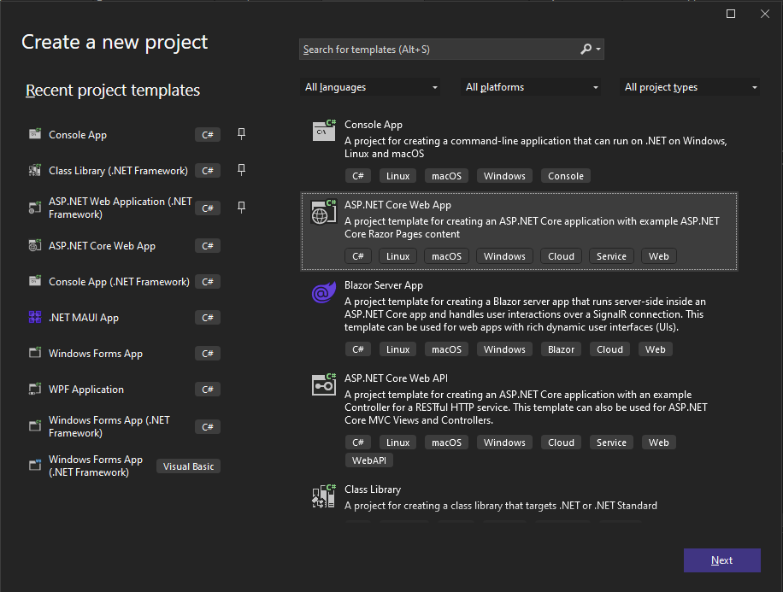
Creating a ASP.NET Core Web App

Slide 9
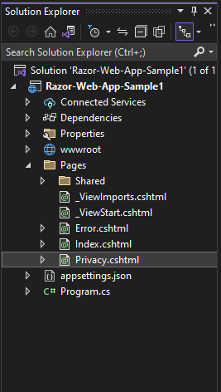
Project Structure
appSettings.json – This file contains configuration data, such as connection strings.
Program.cs – This file contains the entry point for the program. ,it configures app behavior.
wwwroot folder - Contains static files, such as Images, HTML files, JavaScript files, and CSS files.
Pages folder – Here you are supposed to put your ASP.NET (".cshtml") web pages
_Layout.cshtml file configures UI elements common to all pages. You can use this file to set up the navigation menu at the top of the page

Slide 10
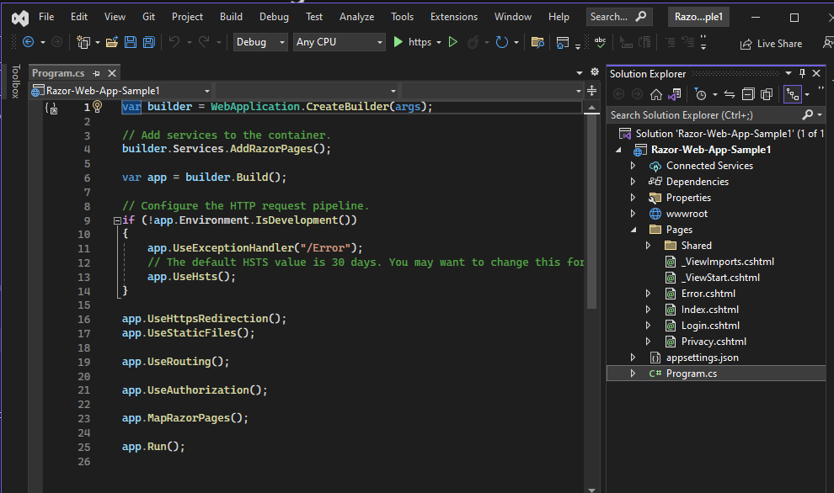
Razor Pages is enabled in program.cs
AddRazorPages adds services for Razor Pages to the app.
MapRazorPages adds endpoints for Razor Pages to the IEndpointRouteBuilder.

Slide 11

Razor page Anatomy
In Razor with Page Model each Razor page is a pair of files: ​
A “.cshtml” file that contains HTML markup with C# code using Razor syntax.​
A “.cshtml.cs” (“code behind” or “Page model” file) file that contains C# code that handles page events.

Slide 12
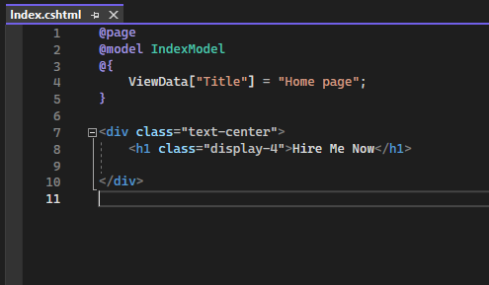
Razor page – .cshtml page
This code looks a lot like a Razor view file used in an ASP.NET Core app with controllers and views. What makes it different is the @page directive.
@page makes the file into an MVC action, which means that it handles requests directly, without going through a controller. @page must be the first Razor directive on a page. @page affects the behavior of other Razorn constructs. Razor Pages file names have a .cshtml suffix.
The @model directive specifies the model type made available to the Razor page

Slide 13

Rendering HTML
The default Razor language is HTML. Rendering HTML from Razor markup is no different than rendering HTML from an HTML file. HTML markup in .cshtml Razor files is rendered by the server unchanged.

Slide 14
Razor syntax
Razor is a markup syntax for embedding .NET based code into webpages. The Razor syntax consists of Razor markup, C#, and HTML. Files containing Razor generally have a .cshtml file extension. Razor is also found in Razor component files (.razor). Razor syntax is similar to the templating engines of various JavaScript single-page application (SPA) frameworks, such as Angular, React, VueJs, and Svelte.
Razor supports C# and uses the @ symbol to transition from HTML to C#. Razor evaluates C# expressions and renders them in the HTML output.
When an @ symbol is followed by a Razor reserved keyword, it transitions into Razor-specific markup. Otherwise, it transitions into plain HTML.
To escape an @ symbol in Razor markup, use a second @ symbol:

Slide 15
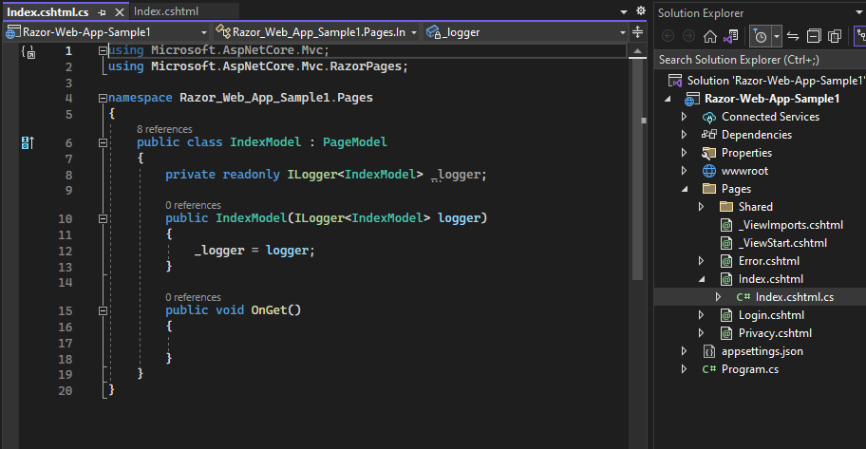
PageModel - .cshtml.cs page
By convention, the PageModel class file has the same name as the Razor Page file with .cs appended.
This is the logic Part of the page .
Page events can be manage here
Encapsulates the data properties and logic operations scoped just to its Razor page.
Defines page handlers for HTTP requests sent to the page and for the data used to render the page.
OnGet to initialize state needed for the page.
OnPost to handle form submissions.

Slide 16
HTML Helpers
In Razor Pages, HTML Helpers are a set of utility methods that simplify the process of generating HTML markup. They provide a convenient and strongly-typed way to generate HTML elements, form controls, links, and more. HTML Helpers help improve code readability, maintainability, and reduce the likelihood of errors.

Slide 17
Here are some commonly used HTML Helpers in Razor Pages:
1 . Form Controls
Html.TextBoxFor and Html.PasswordFor:
These helpers generate <input> elements for text input and password input, respectively. They automatically bind to the model property specified
@Html.TextBoxFor(m => m.Name)
@Html.PasswordFor(m => m.Password)

Slide 18
Html.CheckBoxFor and Html.RadioButtonFor:
These helpers generate checkboxes and radio buttons that bind to a Boolean model property or an enumeration property, respectively.
@Html.CheckBoxFor(m => m.IsSubscribed)
@Html.RadioButtonFor(m => m.Gender, "Male")
@Html.RadioButtonFor(m => m.Gender, "Female")
Html.CheckBoxFor and Html.RadioButtonFor:
These helpers generate checkboxes and radio buttons that bind to a Boolean model property or an enumeration property, respectively.
@Html.DropDownListFor(m => m.CategoryId, Model.Categories, "Select a category")

Slide 19
2 . Links and URLs:
Html.ActionLink:
This helper generates an <a> tag for a link to an action method within the same controller or a different controller.
@Html.ActionLink("Home", "Index", "Home")
Html.RouteLink:
This helper generates a link based on a named route and its parameters
@Html.RouteLink("About Us", "AboutRoute")

Slide 20
3 . Partial Views
Html.Partial:
This helper renders a partial view within the current view. It can be used to reuse sections of markup.
@Html.Partial("_PartialViewName")

Slide 21
4 . Displaying Data
Html.DisplayFor:
This helper generates HTML markup to display the value of a model property, applying any specified display templates or formatting.
@Html.DisplayFor(m => m.Name)
Html.EditorFor:
This helper generates an appropriate editor control for a model property, using any specified editor templates.
@Html.EditorFor(m => m.DateOfBirth)

Slide 22
Razor Page Events
In Razor Pages, events are a way to handle user interactions or specific actions that occur during the lifecycle of a page. Events allow you to respond to user input or perform certain operations in response to various triggers. Here are some commonly used events in Razor Pages:
Page Events
Handler Events

Slide 23
Page Events
OnGet and OnPost: These events are triggered when an HTTP GET or POST request is made to the page. You can override these methods in your Razor Page's code-behind file (PageModel) to handle the corresponding HTTP verb.
public IActionResult OnGet()
{
// Logic for handling HTTP GET request
return Page();
}
public IActionResult OnPost()
{
// Logic for handling HTTP POST request
return Page();
}

Slide 24
Page Events
OnGetAsync and OnPostAsync: Similar to OnGet and OnPost, these events are asynchronous versions and allow you to perform async operations during the request handling.
public async Task<IActionResult> OnGetAsync()
{
// Asynchronous logic for handling HTTP GET request
return Page();
}
public async Task<IActionResult> OnPostAsync()
{
// Asynchronous logic for handling HTTP POST request
return Page();
}

Slide 25
Handler Events
OnGet and OnPost: Similar to page events, these events are associated with individual handler methods. You can define them in your PageModel to handle specific HTTP verbs for a particular handler method.
public IActionResult OnGetDelete()
{
// Logic for handling GET request specific to the "Delete" handler
return Page();
}
public IActionResult OnPostDelete()
{
// Logic for handling POST request specific to the "Delete" handler
return Page();
}

Slide 26
Handler Events
Other Handler Events: Razor Pages also provide events like OnGetHandlerAsync, OnPostHandlerAsync, OnHandlerExecuting, OnHandlerExecuted, etc., which allow you to perform actions before and after the execution of specific handler methods.
These events allow you to handle user input, perform data processing, execute business logic, and control the flow of your Razor Pages application. You can override these events in your page model (PageModel class) to define the desired behavior for your application.

Slide 27
Razor Page Filters
Filters are a powerful feature that allow you to add cross-cutting concerns to your application. They enable you to execute code before or after specific stages in the Razor Pages lifecycle or before or after individual page handler methods.
There are two types of filters in Razor Pages:
Page Filters
Handler Filters

Slide 28
Razor Page Filters
Page Filters: These filters are applied at the page level and can be used to perform actions before or after the entire page is executed. They are defined using the PageModel base class and can be used to handle scenarios like authentication, authorization, logging, caching, and so on.
Handler Filters: These filters are applied at the individual page handler method level and allow you to perform actions before or after a specific handler method is executed. They are defined using attributes and can be used to handle scenarios like input validation, model binding, logging, and so on.

Slide 29
Razor Page Validations
In Razor Pages, you can perform validations on user input to ensure that the data entered by the user meets certain criteria or constraints.
There are various ways to implement validations in Razor Pages, including client-side and server-side validations.

Slide 30
Client Side Validation
Required Fields: You can use the data-val-required and data-val attributes to mark fields as required. Razor Pages automatically generates the necessary JavaScript validation code based on these attributes.
<input asp-for="Name" data-val="true" data-val-required="The Name field is required" />
<span asp-validation-for="Name"></span>

Slide 31
Client Side Validation
Data Type Validations: You can use data annotations on your model properties to specify the expected data types, such as [Required], [StringLength], [Range], etc.
public class MyModel
{
[Required]
public string Name { get; set; }
[Range(18, 99)]
public int Age { get; set; }
}

Slide 32
Server Side Validation
ModelState: Razor Pages automatically validates the model state during model binding. You can check for validation errors using the ModelState.IsValid property and display error messages in your Razor Pages.
public IActionResult OnPost()
{
if (!ModelState.IsValid)
{
return Page();
}
// Process valid data
return RedirectToPage("Success");
}

Slide 33
Server Side Validation
Custom Validations: You can create custom validation attributes by deriving from the ValidationAttribute class and overriding the IsValid method. This allows you to implement custom validation logic based on your requirements.
public class CustomValidationAttribute : ValidationAttribute
{
protected override ValidationResult IsValid(object value, ValidationContext validationContext)
{
// Custom validation logic
if (/* validation fails */)
{
return new ValidationResult("Validation failed");
}
return ValidationResult.Success;
}
}
public class MyModel
{
[CustomValidation]
public string SomeProperty { get; set; }
}

Slide 34


